Slide 1


February 22nd, 2019
Presented By: Dhananjay Kumar

Slide 2
Agenda
Software Estimation Definition & Principles
Software Project Estimation Techniques – Function Points
Software Project Estimation Techniques – Planning Poker
Software Project Estimation Techniques – Other Techniques
General Project Estimation Approach

Slide 3
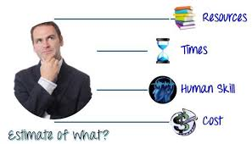
Software Estimation Definition & Principles
Estimation is the process of finding an estimate, or approximation, which is a value that can be used for some purpose even if input data may be incomplete, uncertain, or unstable.
Estimation determines how much money, effort, resources, and time it will take to build a specific system or product
Estimation Base Parameters
Estimation Basic Steps
Past Data/Past Experience
Available Documents/Knowledge
Assumptions
Identified Risks
Estimate the size of the development product.
Estimate the effort in person-months or person-hours.
Estimate the schedule in calendar months.
Estimate the project cost in agreed currency
Observations on Estimation
Estimation need not be one time task and can be done during Acquiring, Planning and Execution of project
Project scope must be understood before the estimation process begins
Project metrics can provide a historical perspective and valuable input for generation of quantitative estimates
Planning requires technical and management team to make an initial commitment as it leads to responsibility and accountability
Use at least two estimation techniques to arrive at best estimate values
Plans should be iterative and allow adjustments as time passes

Slide 4
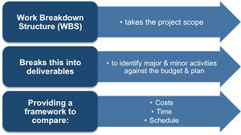
General Project Estimation Approach
Decomposition Technique is widely used General Project Estimation Approach where divide and conquer approach is used for Size, Effort and Cost estimation in a stepwise manner by breaking down a Project into major Functions or related Software Engineering Activities.
Decomposition between Deliverables and Work Package provides Output of Scope Management
WBS (Work Breakdown Structure)
Project
Phases
Deliverables
Work Packages
Activities
Decomposition between Work Package and Activities provides Output of Time Management
WBS is most common Decomposition Technique. It’s well suited for less complex and small to medium size projects.

Slide 5
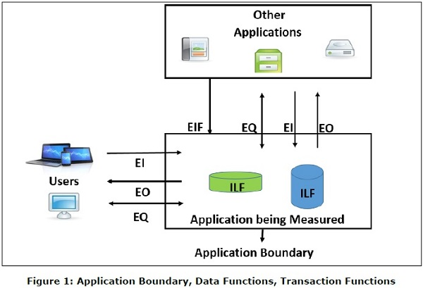
Software Project Estimation Techniques – Function Points
Function
Data Function
Internal Logical Files (ILF)
External Interface Files (EIF)
Transaction Function
External Inputs (EI)
External Inquiries (EQ)
External Outputs (EO)
A Function Point (FP) is a unit of measurement to express the amount of business functionality. Function Points measure software size. It has two components Function Point Analysis (FPA) technique (quantifies functions) & Function Points (FP) Counting (governs standard set of rules). This estimation technique is suitable for Medium to Large projects.
Function | Definition
Data Function | Data Functions are made up of internal and external resources that affect the system
Transaction Function | Transaction functions are made up of the processes that are exchanged between the user, the external applications and the application being measured.
Internal Logical Files (ILF) | An ILF has the inherent meaning that it is internally maintained, it has some logical structure and it is stored in a file.
External Interface Files (EIF) | An EIF has the inherent meaning that it is externally maintained, an interface has to be developed to get the data from the file.
External Inputs (EI) | External Input (EI) is a transaction function in which Data goes “into” the application from outside the boundary to inside.
External Outputs (EO) | External Output (EO) is a transaction function in which data comes “out” of the system.
External Inquiries (EQ) | External Inquiry (EQ) is a transaction function with both input and output components that result in data retrieval.

Slide 6
Software Project Estimation Techniques – Function Points (Cont..)
FP Counting Process involves the following steps
Determine the type of count
Determine the boundary of the count
Identify each Elementary Process (EP) required by the user
Determine the unique EPs
Measure data functions
Measure transactional functions
Calculate functional size (unadjusted function point count)
Determine Value Adjustment Factor (VAF)
Calculate adjusted function point count
FP Counting – Case Study
ABC Inc. a company which sells goods on the phone, wants a system to be developed which will be able to control the whole stock, from orders to payments. They want to estimate the development complexity and also want to predict development timelines.
Development FP in this case. Other two are Application & Enhancement FP.
Customers, Order, Stock, Stock Details, Credit Rating, Payment Details, Good File, Good Transaction File
External Interface Files - there's no EIFs to consider
Internal Logical Files - Customer, goods files, goods transaction files.
External Inputs - customer, order, stock, and payment details.
External Outputs - customer, order, stock details, credit rating.
External Inquiries - customer, order, stock details.
Next three steps to be explained in next slide
All meaningful transactions like : Customers, their Order, Stock enquiry, Stock Details, customer Credit Rating, Payment Details, Good File details etc.
Purpose of FP, Scope of Application and business area. Here customers, stock, and transactions

Slide 7
Software Project Estimation Techniques – Function Points (Cont..)
Functional Complexity for Each Data Function
Functional Complexity for Each Transaction Function
Functional Size for Each Transaction Function
RETS | Data Element Types (DETs)
 | 1-19 | 20-50 | >50
1 | Low | Low | Avg.
2 to 5 | Low | Avg. | High
>5 | Avg. | High | High
FTRs | Data Element Types (DETs)
 | 1-4 | 5-15 | >=16
0-1 | Low | Low | Avg.
2 | Low | Avg. | High
>=3 | Avg. | High | High
Complexity | FP Count
Low | 3
Average | 4
High | 6
Functional Size for Each Data Function
FTRS: File Type Referenced: Largest user identifiable sub group within EI, EO & EQ. In this case two.
EQ must have a minimum of 1 FTR
Functional Complexity | FP Count for ILF | FP Count for EIF
Low | 7 | 5
Average | 10 | 7
High | 15 | 10
Prediction Table for Case Study
Function Point Calculation
Category | Multiplier | Weight
EI | 4 | 3
EO | 4 | 4
EQ | 3 | 3
ILF | 3 | 7
Function Point = 4*3+4*4+3*3+3*7=58
If One FP takes 08 Hrs. to complete, total Development Time is : 58*8 = 464 Hrs.
RETS: Record Element Type: Largest user identifiable sub group (how many type of users will use it). In this case two.
DET : Data Element Type : Number of unique transactions with file / database by each sub groups

Slide 8

Software Project Estimation Techniques – Planning Poker
Planning Poker is a consensus-based technique for estimating, mostly used to estimate effort or relative size of user stories in Scrum. Planning Poker is played with a deck of cards. As Fibonacci sequence is used, the cards have numbers - 1, 2, 3, 5, 8, 13, 21, 34, etc. These numbers represent the “Story Points”.
Facilitator reads items to be estimated, moderates brief discussion to clarify details, and calls for estimates.
Facilitator calls for vote, and all Estimators turn over cards at the same time.
Each Estimator places estimate face down, hiding the value.
If all cards agree, their values is recorded as the estimate. Otherwise, Facilitator asks high and low Estimators to explain their reasoning, and moderates brief discussion to clarify issues.
Repeat 2-5 until estimates coverage.
Practice Case Study

Slide 9
Software Project Estimation Techniques – Other Techniques
Estimation Technique | Details
COCOMO | The Constructive Cost Model (COCOMO) is a procedural software cost estimation model. The model parameters are derived from fitting a regression formula using data from historical projects.
Three Points | Three-point Estimation looks at three values the most optimistic estimate (O), a most likely estimate (M), and a pessimistic estimate (least likely estimate (L)).
The Bucket System | This system is a good alternative when estimating a large number of items with a large group of participants. Create several buckets in the sequence of planning poker. The group estimates the items by placing them in these “buckets”. This is much faster than planning poker.
PERT | Project Evaluation and Review Technique (PERT) estimation also based on three values: the most optimistic estimate (O), a most likely estimate (M), and a pessimistic estimate (least likely estimate (L)), however evaluation process is different than three points.
T-Shirt Sizes | This is a perfect technique for estimating a large backlog of relative large items. Especially when you have several concurrent scrum teams working on the same product. Items are estimated into t-shirt sizes: XS, S, M, L, XL. The decision about the size is based on an open and mutual collaborative discussion. This method is an informal and quick way to get an rough feeling about the total size of your backlog.
Use-case, Delphi, Analogous | These are some other estimation techniques.

Slide 10
Thank You !

